Slide 1
DEVELOPMENT OF ATTENDANCE VERIFICATION MODEL USING IMAGE ANALYTICS
Ritvik Mittal
Vidit Goyal

Slide 2
Introduction
NAME | VIDIT GOYAL | RITVIK MITTAL
ID No. | 2021B4AA2944G | 2021A8PS2545P
Campus | GOA | PILANI
Branch | B.E. Electronics and Communication Engineering and MSc. Mathematics | B.E. Electronics and Instrumentation Engineering

Slide 3
PS-1 : Station Information
NAME: Unicloud LOCATION: Sector-4, Noida CLIENT NAME: Ministry of Rural Development (MoRD) LOCATION: Connaught Place, New Delhi PROJECT NAME: Development of Attendance Verification Model using Image
Analytics

Slide 4
Mahatma Gandhi National Rural Employment Guarantee Act 2005

Slide 5
Introduction to MGNREGA
MGNREGA stands for Mahatma Gandhi National Rural Employment Guarantee Act.
It is a social welfare program initiated by the Government of India in 2005.
Aimed at providing employment opportunities and improving livelihoods in rural areas.
Implemented across all rural districts of India.

Slide 6
Objectives of MGNREGA
Ensure the right to work for rural households by providing at least 100 days of guaranteed wage employment.
Generate productive and durable assets such as water conservation structures, rural infrastructure, and agricultural development.
Empower rural communities by strengthening the livelihood resource base.
Create sustainable development in rural areas and reduce distress migration.

Slide 7
Key Features of MGNREGA
Demand-driven: Individuals in rural households can request employment and work is provided within 15 days of the request.
Unskilled manual work: Focuses on labor-intensive activities to create employment opportunities for the rural poor.
Minimum wage: Workers are entitled to receive the minimum wage fixed by the state government.
Equal wages for men and women: Ensures gender equality by providing equal wages for both men and women.
Social audit: Regular audits to ensure transparency, accountability, and effective implementation.

Slide 8
Impact of MGNREGA
Employment generation: Over the years, millions of job opportunities have been created, benefitting rural households.
Poverty reduction: MGNREGA has played a crucial role in reducing poverty and improving living conditions in rural areas.
Infrastructure development: Creation of durable assets like roads, irrigation canals, and water conservation structures has improved rural infrastructure.
Social inclusion: Increased participation of marginalized communities and women, leading to social empowerment and reduced gender disparities.
Environmental benefits: Focus on natural resource management has resulted in ecological restoration and conservation.

Slide 9
Research Goal

Slide 10
Research Problem
The Mahatma Gandhi National Rural Employment Guarantee Act (MGNREGA) 2005 plays a crucial role in providing employment opportunities and social security to rural households in India.
However, the manual process of verifying attendance poses significant challenges, including errors, time-consuming procedures, and potential instances of fraudulent reporting.

Slide 11
Fraudulent Reporting
We confront a substantial predicament characterized by a scenario wherein the number of registered individuals within a specific gram panchayat does not correspond to the count captured in the associated attendance picture.
This discrepancy in attendance counts engenders profound concerns regarding the potential financial implications and the potential misappropriation of allocated funds within the MGNREGA framework.

Slide 12
Research Objectives
The primary objective of this research is to automate the process of attendance checking through the implementation of an automated system, using Python.
By eliminating the manual and time-consuming task of physically taking attendance, this research aims to streamline and enhance efficiency in various educational and professional settings.
To accomplish this goal, an extensive dataset comprising images of individuals in an Indian context was meticulously curated and employed in the training process

Slide 13
Research Objectives
The results obtained from the testing phase were recorded and analyzed. Various metrics, such as precision, recall, and F1 score, were employed to assess the system's accuracy.
We aspire to transcend the boundaries of a standalone system. Recognizing the importance of scalability and user-friendliness, we aim to design and implement an application programming interface (API).
This API would facilitate the seamless integration of the developed attendance check system into existing technological infrastructure.

Slide 14
Training Models

Slide 15
YOLO v8

Slide 16
Introduction to YOLO V8
YOLO V8 stands for "You Only Look Once" Version 8.
It is an object detection algorithm widely used in computer vision tasks.
YOLO V8 was developed by Joseph Redmon and Ali Farhadi in 2018.
It offers real-time object detection with high accuracy.

Slide 17
How YOLO V8 Works
YOLO V8 follows a single-shot detection approach, meaning it detects objects in a single pass through the network.
It divides the input image into a grid and predicts bounding boxes and class probabilities for each grid cell.
The predictions are made at different scales to handle objects of varying sizes.
YOLO V8 uses a deep convolutional neural network (CNN) architecture for feature extraction and object detection.

Slide 18
Applications of YOLO V8
YOLO V8 finds applications in various domains, including autonomous driving, surveillance, object tracking, and robotics.
It enables real-time object detection and tracking, making it valuable for real-time systems.
YOLO V8 has been trained on large-scale datasets and can detect a wide range of objects, including people, vehicles, animals, and everyday objects.
It provides a foundation for building advanced computer vision applications that require robust and efficient object detection capabilities.

Slide 19
Advantages and Limitations
Advantages:
Real-time object detection
High accuracy
Efficient single-shot detection
Wide range of detectable objects
Limitations:
May struggle with small objects or objects with complex shapes
Can have difficulty in dense scenes with overlapping objects

Slide 20
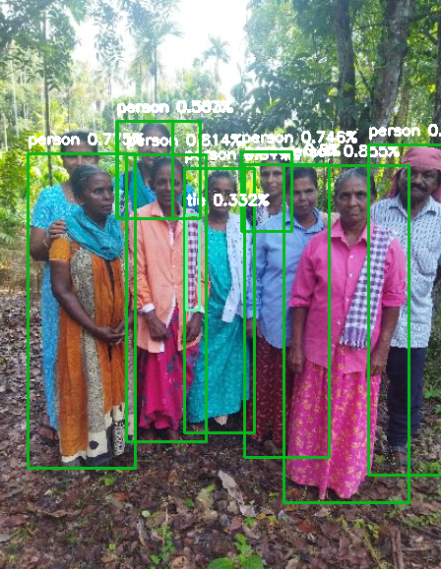
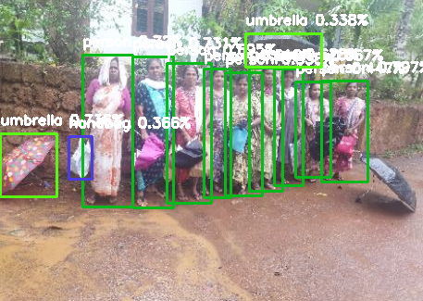
Working Examples

Slide 21
MTCNN

Slide 22
Multi Task Cascaded Convolutional Neural Networks (MTCNN) Model
The MTCNN (Multi-task Cascaded Convolutional Networks) model is a deep learning-based algorithm used for face detection and alignment.
MTCNN has gained significant popularity due to its robustness and accuracy in detecting and aligning faces in images.
One of the significant advantages of MTCNN is its ability to handle faces in different poses, orientations, and scales. It employs a multi-scale approach to detect faces at different resolutions.
Additionally, MTCNN can handle partial occlusions, where only a portion of the face is visible.

Slide 23
Working of MTCNN
The MTCNN model consists of three stages: face detection, facial landmark localization, and bounding box regression.
In the first stage, a convolutional neural network (CNN) is used to propose potential face regions in the input image.
The second stage refines the face proposals by accurately localizing the facial landmarks, such as eyes, nose, and mouth.
Finally, in the third stage, a bounding box regression is applied to adjust the face regions and align them for further analysis.

Slide 24
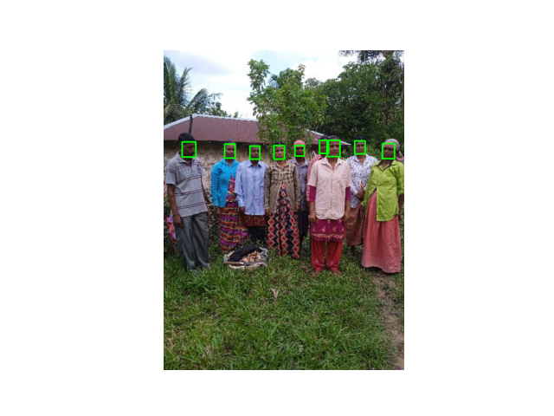
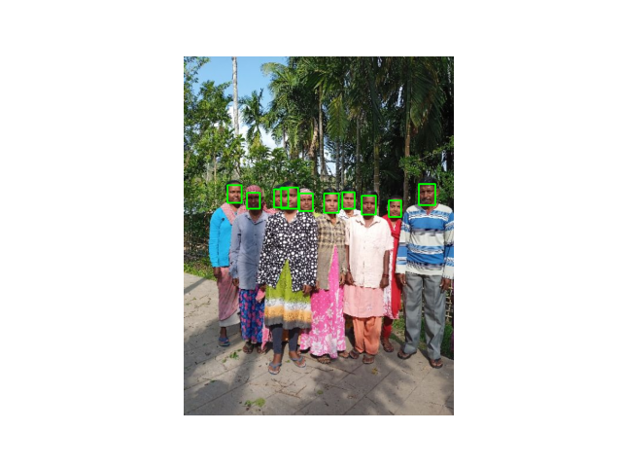
Example Working

Slide 25
Data Collection Process

Slide 26
Introduction to Confusion Matrix
A confusion matrix is a performance evaluation tool used in machine learning and statistics.
It provides a summary of the performance of a classification model.
The matrix displays the true positive, true negative, false positive, and false negative values.
It helps assess the model's accuracy, precision, recall, and other metrics.

Slide 27
Usage and Importance of Confusion Matrix
The confusion matrix helps evaluate the performance of a classification model by measuring its predictive accuracy.
It aids in identifying the types of errors made by the model, such as false positives and false negatives.
The matrix allows for the calculation of various evaluation metrics like precision, recall, F1 score, and accuracy.
It provides valuable insights for model optimization, threshold adjustment, and decision-making.

Slide 28
Process of Data Collection
Meeting Atul sir he told us to collect images and start our testing.
We decided to use both YOLO and MTCNN and then compare results.
We got more than 1000 images and started testing.
After some time we realised that the images were very bad quality so the results were impossible to test.

Slide 29
Process of Data Collection
After discussing this with Ravinath Sir he told us to sort out pictures that are clear and then test.
After that we chose 30 images and then tested our results on both YOLO and MTNCC.
Then we tested on YOLO from confidence level 0.4 to 0.7.
And on MTCNN from 0.4 to 0.8 and filled them into an excel sheet.
Under are some examples

Slide 30
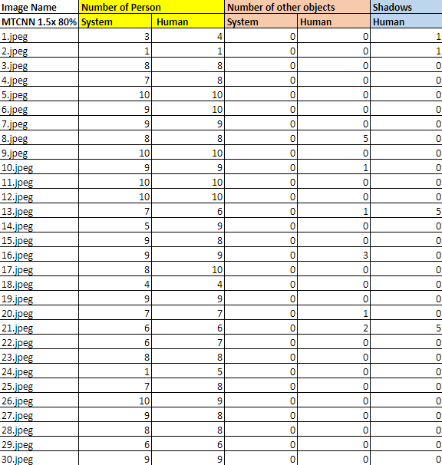

Slide 31
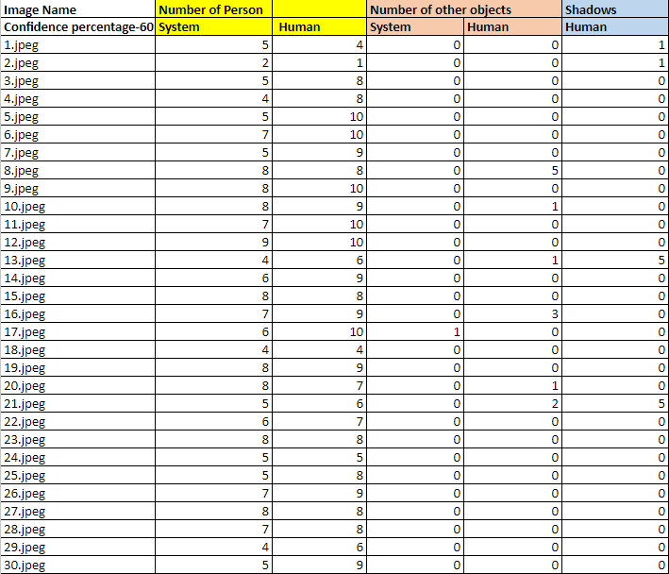

Slide 32
Evaluation Process

Slide 33
Evaluation of Models
Analyzed the performance of MTCNN and YOLO models for face detection.
Explored different confidence thresholds and upscaling factors to gain insights into the models' behavior.
Variations in confidence threshold allowed us to examine the trade-off between precision and recall.
Identified limitations in the YOLO model, including false detections due to shadows and difficulty in accurately distinguishing individuals in challenging scenarios.

Slide 34
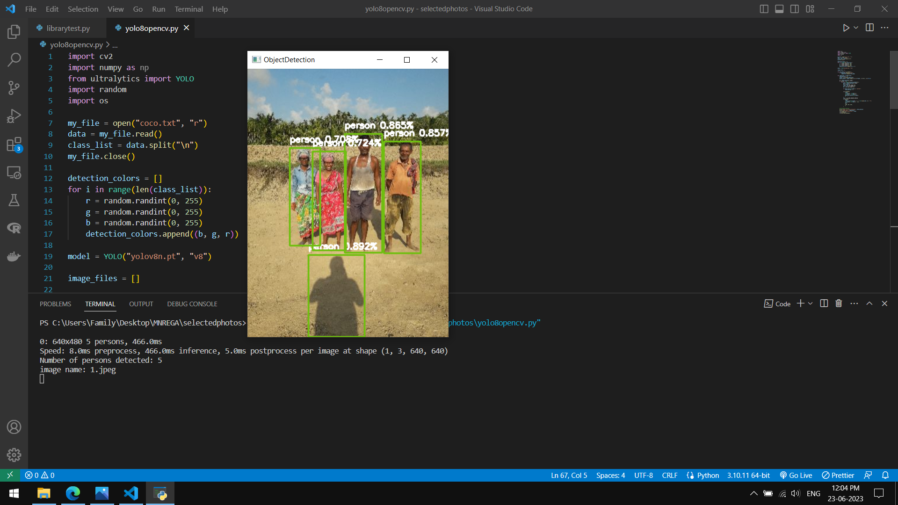
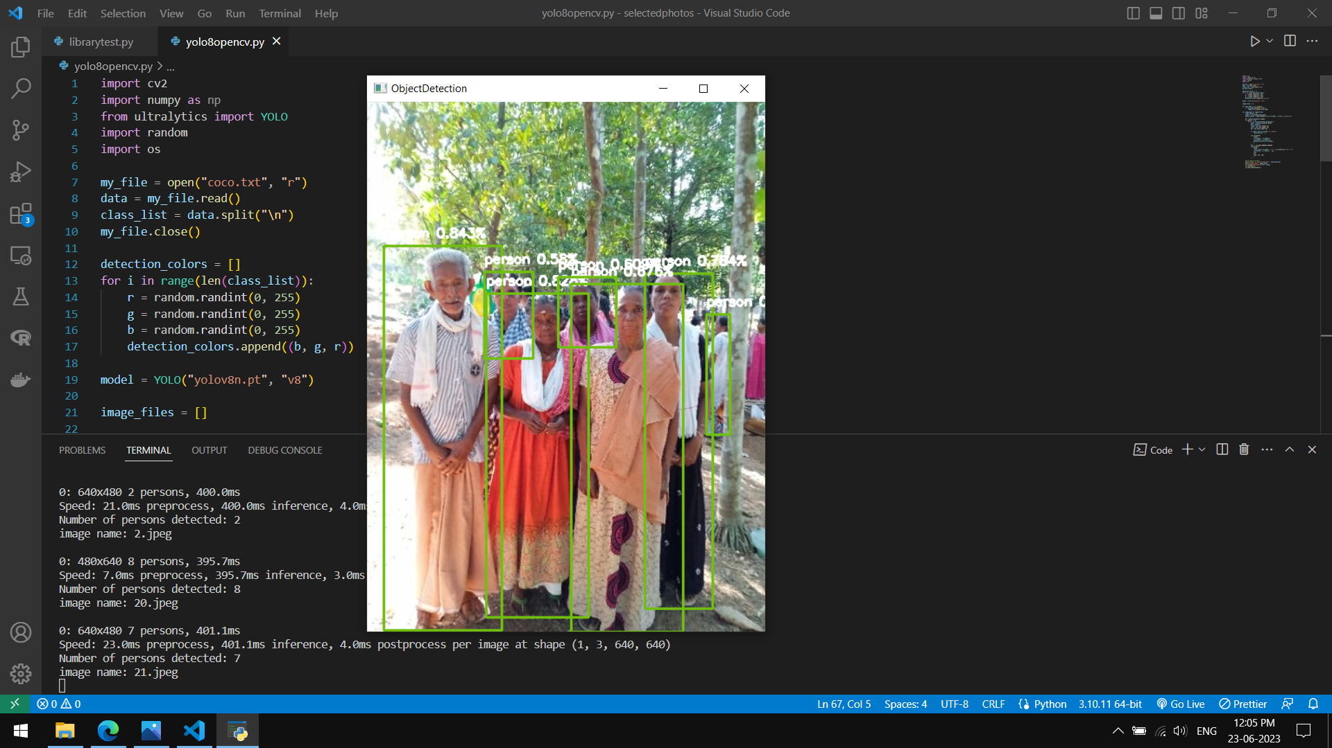
YOLO v8 Limitations

Slide 35
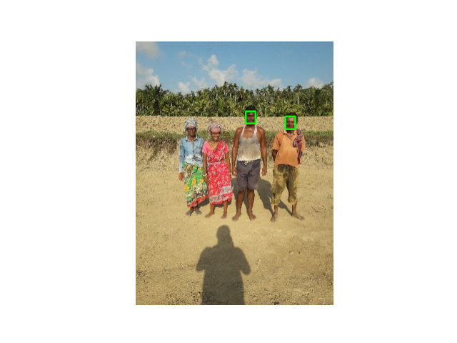
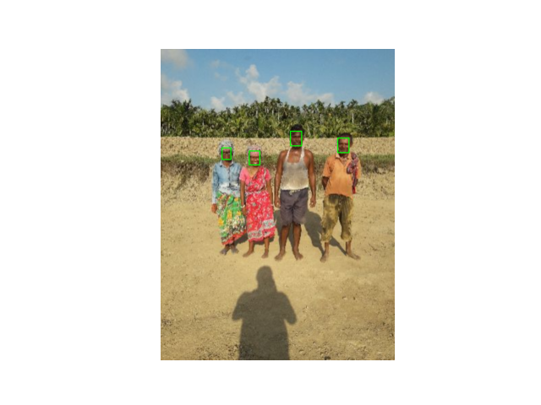
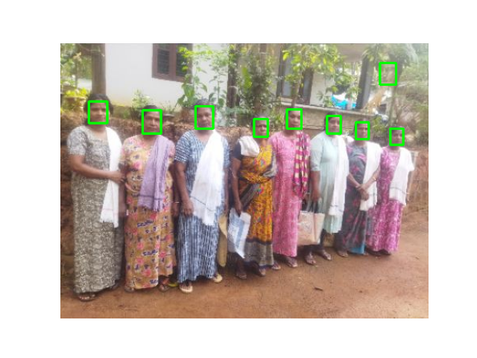
MTCNN Limitations
In contrast, in the case of the MTCNN model, we focused on mitigating the occurrence of extra face detections. Extra face detections refer to instances where the model erroneously identifies additional faces that are not present in the scene or intended for recognition.

Slide 36
Resolution
We explored various techniques and strategies, such as fine-tuning the model's parameters, adjusting the thresholds for face detection, and optimizing the face detection algorithm.
Overall, the evaluation process involved an in-depth analysis of the MTCNN and YOLO models' performance, considering different confidence thresholds, upscaling factors, and specific challenges encountered during face detection.
By examining the confusion matrices and addressing the identified issues, we aimed to refine and improve the accuracy and reliability of both models in their respective face detection tasks.

Slide 37
Rest API Implementation and Scope

Slide 38
API Implementation
In order to streamline the image upload and processing workflow, we explored the concept of REST API (Representational State Transfer Application Programming Interface).
The REST API enables seamless communication between the image upload system and the server responsible for image processing and result generation.
REST API follows a widely adopted architectural style for designing networked applications, employing a client-server model.

Slide 39
Working of RESTAPI
Clients can make requests to the server, and the server responds with the requested data or performs the desired actions.
In our case, the server receives the uploaded images, processes them using specified algorithms (such as MTCNN or YOLO), and returns the relevant results to the client.
Implementation of the REST API requires defining a set of endpoints that represent different functionalities or resources.
These endpoints govern how clients interact with the server, ensuring a smooth and efficient workflow.

Slide 40
Integration with NMMS App and MNREGA website
The implementation of secure communication methods is crucial to facilitate effective client-server interaction.
These security measures safeguard the REST API from unauthorized access and maintain data integrity.
Once the REST API is developed and thoroughly tested, it can be deployed on the MNREGA website and seamlessly integrated into the NMMS app.
This integration allows users of both platforms to conveniently upload batches of images, triggering server-side processing, and receiving the desired results in return.

Slide 41
Conclusion

Slide 42
Conclusion
MTCNN outperformed YOLO v8 in face recognition, effectively avoiding shadow detection as additional human beings.
Increasing the resolution in MTCNN (125%, 150%, or 200%) resulted in slightly improved results.
The next phase of our project involves developing a confidence matrix using these resolutions and confidence levels of 0.7, 0.8, and 0.9.
We plan to integrate the confidence matrix into an API, enabling accurate head count analysis of people in a large number of images.

Slide 43
Conclusion
Our findings highlight the potential for real-world applications of the developed system, offering enhanced accuracy and reliability in headcount analysis.
Through this project, we have advanced our understanding of face recognition models and their performance under different conditions.
The successful integration of the confidence matrix into the API will pave the way for efficient and effective headcount analysis in various scenarios.

Slide 44
QNA

